Slide 1
User Awareness & Training: ATMOSPHERE Bucharest, Romania – 8th November 2013 Stefania Mazzeo

Slide 2
Contents
Overview of the Copernicus Atmosphere service
Air Quality & Atmospheric Composition domain
The projects providing the value chain:
MACC-II, Pasodoble, obsAIRve
Live Demonstration – The MACC portal
Live Demonstration – The Test Case
Long-range pollution transport impact on AQ in remote regions
Live Demonstration – Tools to access and use the products
Summary & Questions
Notes:
The Copernicus Atmosphere be around the scope as described in the Implementation group report, as mostly implemented in MACC-II, and also here adaptations could happen.
PASODOBLE, obsAIRve:
Those are downstream services not necessarily with functionalities which are automatically being included in Copernicus Atmosphere.
They certainly provide important aspects in the entire value chain and there are also aspects which could be integrated in Copernicus Atmosphere.
Actually that happened already for PASODOBLE I believe.
But the main idea remains to provide with Copernicus infrastructure and services a platform on which further specific applications could build on but not funded by Copernicus.

Slide 3
The Copernicus Atmosphere Service
MACC-II – Monitoring Atmospheric Composition and Climate - Interim Implementation - is the current pre-operational Copernicus Atmosphere Service
MACC-II provides:
Data records on atmospheric composition for recent years;
Data for monitoring present conditions;
Forecasts of the distribution of key constituents for a few days ahead
MACC-II combines state-of-the-art atmospheric modelling with Earth observation data to provide information services covering European air quality, global atmospheric composition, climate forcing, the ozone layer and UV and solar energy, and emissions and surface fluxes

Slide 4
The Air Quality Service
Air Quality & Atmospheric Composition Air quality is defined as “The quality of the air that one directly breathes at the surface”
Small scale: Health conditions – respiratory disease
Large scale: Desert dust plumes, transportation of atmospheric pollutants and ash plumes from volcanic eruptions, but also variations and long-term changes in the background concentrations of trace components
MACC-II uses a comprehensive global monitoring and forecasting system that estimates the state of the atmosphere on a daily basis, combining information from models and observations and provides a daily 5-day forecast
MACC-II provides the boundary conditions for an ensemble of more detailed regional air quality models → used to zoom in on the European domain → produce 4-day forecasts of air quality
Notes:
It directly affects lives of most European citizens. It forms a significant risk factor for various health conditions and can also aggravate existing health conditions, such as respiratory disease. On a larger scale, atmospheric composition represents the full state of the global atmosphere covering phenomena such as desert dust plumes, long-range transport of atmospheric pollutants and ash plumes from volcanic eruptions, but also variations and long-term changes in the background concentrations of trace components.
Atmospheric composition represents the full state of the global atmosphere covering phenomena such as desert dust plumes, long-range transport of atmospheric pollutants and ash plumes from volcanic eruptions, but also variations and long-term changes in the background concentrations of trace components.
The global modelling system is also used to provide the boundary conditions for an ensemble of more detailed regional air quality models that are used to zoom in on the European domain and produce 4-day forecasts of air quality.

Slide 5
MACC II

Slide 6
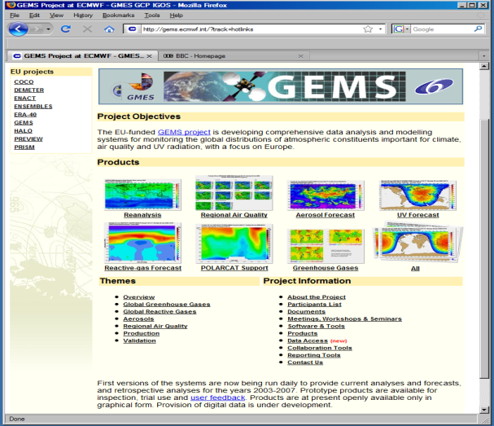

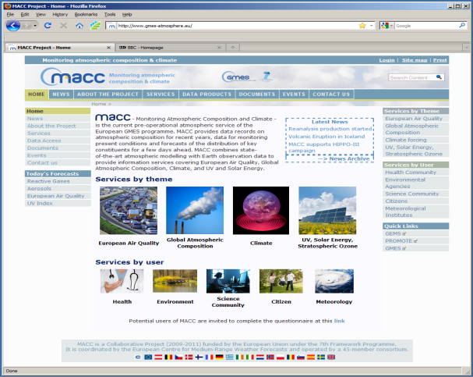
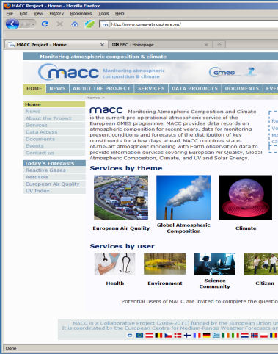
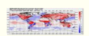

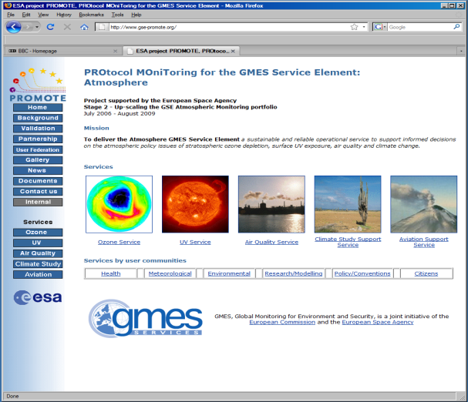
Heritage: from GMES and PROMOTE to MACC and MACC-II
Mar 2005 – May 2009
“Producer-driven”: Primary aim is to build and demonstrate a new capability to meet generally-expressed user requirements
Nov 2011 –
Jul 2014
Jun 2009 – Dec 2011
Apr 2004 – Dec 2009
“User-driven”: Primary aim is to provide services that users require and help to specify using existing capability
“Driven by a user/producer partnership”: Aim is to provide services that meet users’ varied and evolving requirements as fully, effectively and efficiently as possible, taking into account (and working to reduce) scientific, technological and funding constraints
Notes:
MACC-II is the prototype for the GMES Atmospheric Service, now with an heritage of 7+ years

Slide 7
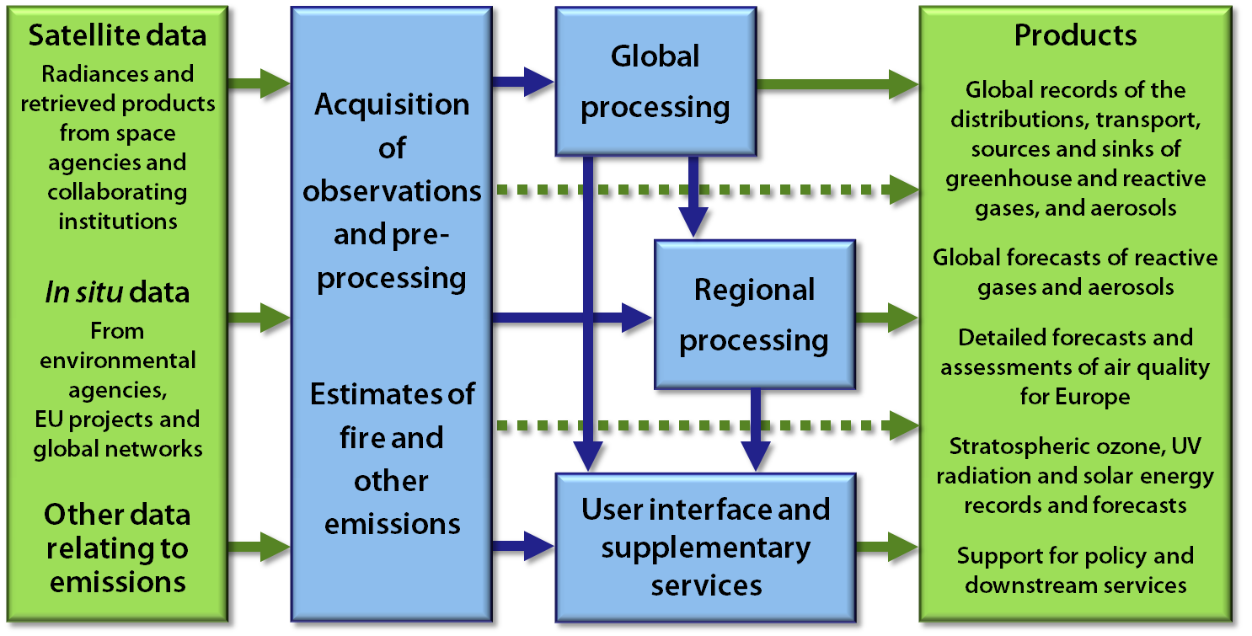

Project Structure and Main Products
Figure from MACC-II description of work: MACC-II is coordinated by ECMWF and the consortium comprises 36 partners from 13 countries. It runs until July 2014,
when Copernicus operations are expected to start.
Notes:
MACC-II is building upon a service chain that is very similar to numerical weather prediction. The project has already been presented by M. Kloeppel in the plenary session.

Slide 8


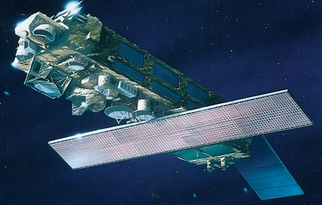
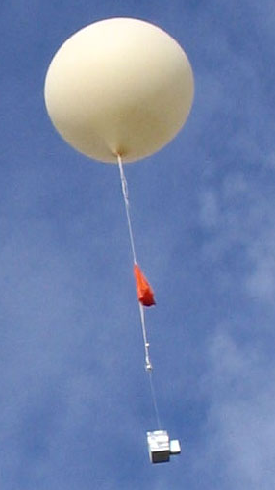
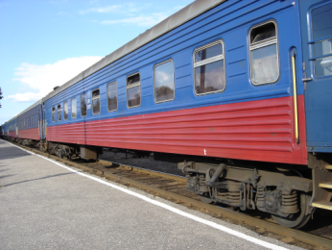
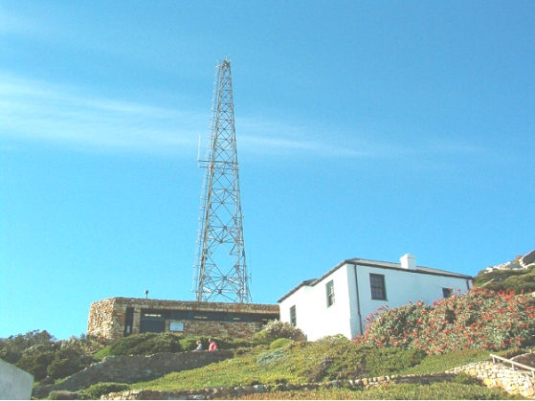
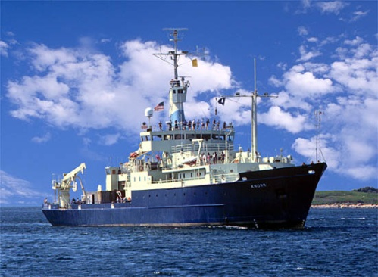
The Global Monitoring Network for Atmospheric Composition
Aeroplanes
Satellites
Balloons
Trains
Ground-based stations
Ships
Notes:
MACC-II considers a wide range of observation for assimilation and verification of the services.

Slide 9
Satellite Reactive Gas Data used in MACC Reanalysis
Instrument | Satellite | Provider | Version | Species | Type | Period | Status
GOME | ERS-2 |  |  | O3 | Profiles | 20030101-20030531 | Active
MIPAS | Envisat | ESA |  | O3 | Profiles | 20030127-20040326 | Active
MLS | AURA | NASA | V02 | O3 | Profiles | 20040808 - | Active
OMI | AURA | NASA | V003 | O3 | Total column | 20041001 - | Active
SBUV | NOAA-16 | NOAA | V8 | O3 | 6 layer profiles | 20040101 - | Active
SBUV | NOAA-17 | NOAA | V8 | O3 | 6 layer profiles | 20030101 - | Active
SBUV | NOAA-18 | NOAA | V8 | O3 | 6 layer profiles | 20050604 - | Active
SCIAMACHY | Envisat | KNMI |  | O3 | Total column | 20030101 - | Active
MOPITT | TERRA | NCAR | V4 | CO | Total column | 20030101 - | Active
OMI | AURA | KNMI | Col. 3 | NO2 | Tropospheric column | 20041001 - | Passive
SCIAMACHY | Envisat | KNMI | V1.1 | NO2 | Tropospheric column | 20030101 - | Active
OMI | AURA | NASA | V003 | SO2 | Total column | 20040817 - | Passive
SCIAMACHY | Envisat | BIRA |  | SO2 | Total column | 20040104 - | Passive
OMI | AURA | NASA | V003 | HCHO | Total column | 20040827 - | Passive
SCIAMACHY | Envisat | BIRA | V2 | HCHO | Total column | 20030101 - | Passive
Notes:
The list of satellite data streams used is already large (>15) on top of ~50 other data used for the meteorology. To our knowledge, such a system with 60+ instrument assimilated has no equivalent worldwide.

Slide 10
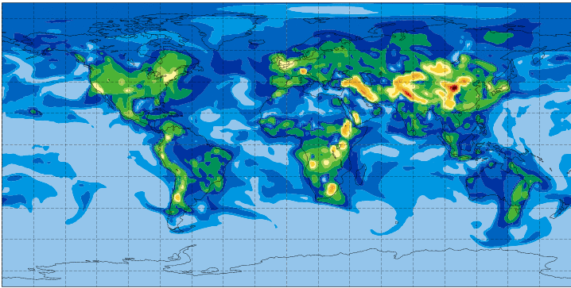
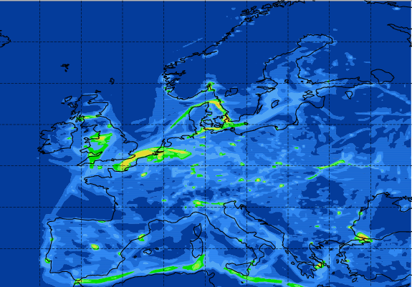
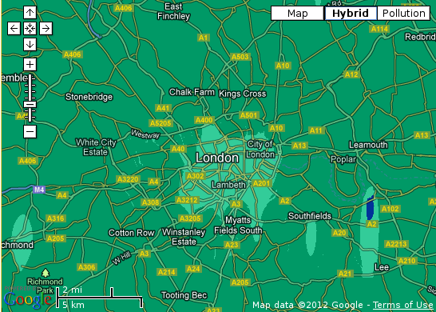

Establishing product chains with users at each level
MACC-II global
MACC-II regional
CERC Airtext, obsAIRve…
Notes:
MACC-II builds upon service chains, partly operated as part of the project (global, regional/Europe), partly operated as part of downstream projects (PASODOBLE, obsAIRve,…) or other initiatives.

Slide 11
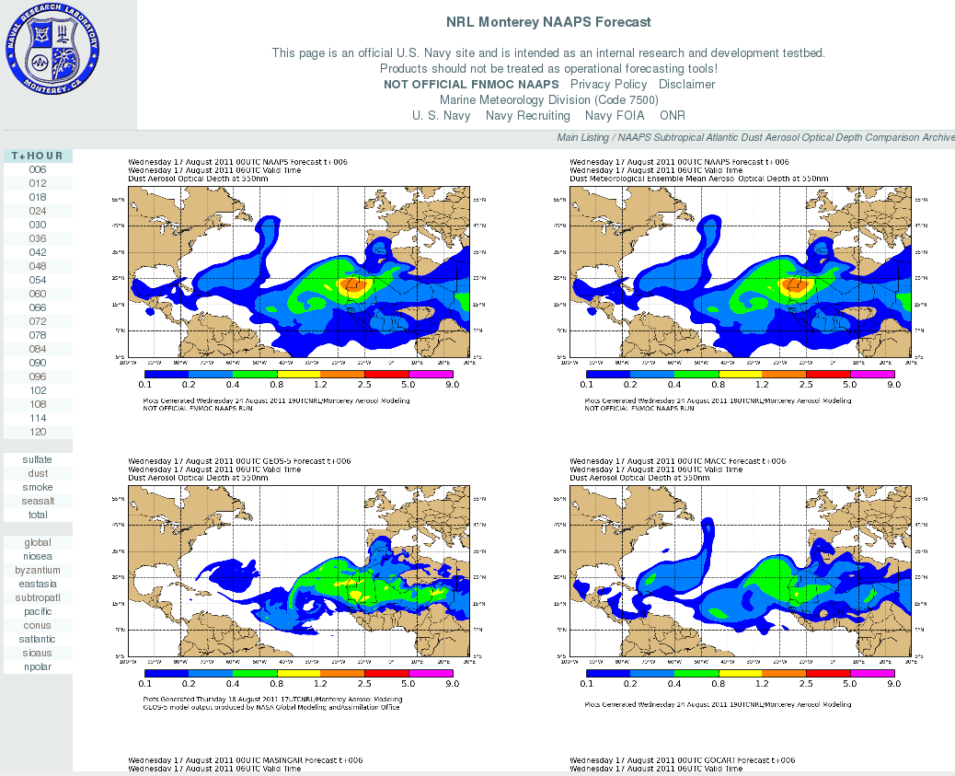
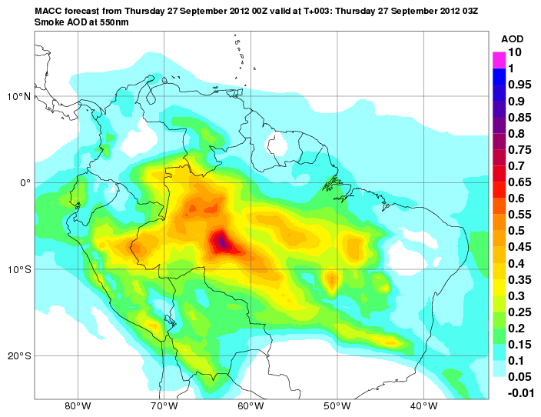
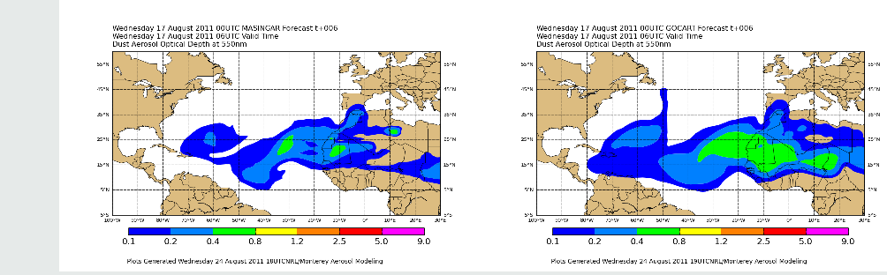
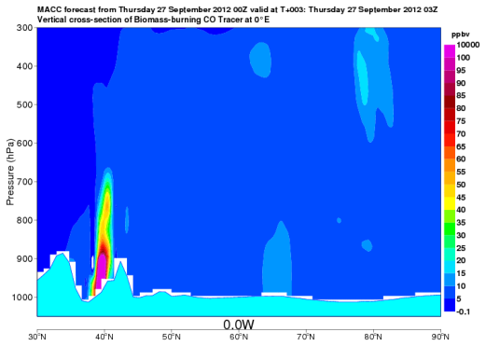
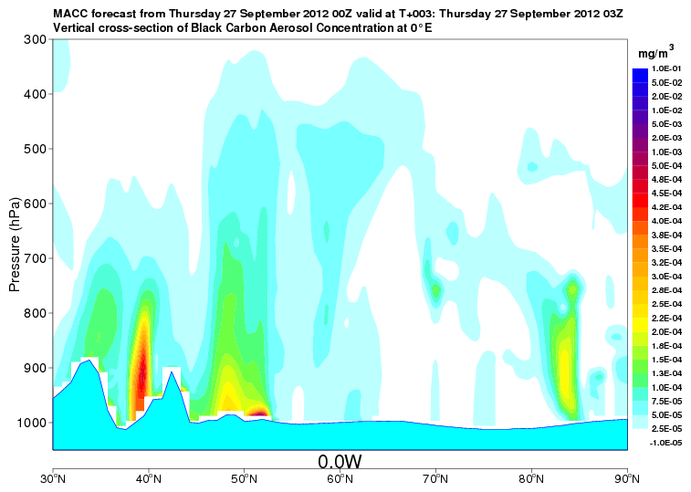
MACC and the International Community
Dust
NRL-deter
NRL-ens
GMAO
MACC
SAMBBA – biomass burning in Brazil
JMA
NCEP
Model ensembles for dust
Flight campaign support
ICAP (International Cooperation on Aerosol Prediction) graphics by W. Sessions, NRL
ACCESS & TRAQA – pollution in Arctic & Europe
Notes:
MACC-II is very well integrated in the international community, is active in setting up collaborations (eg ICAP) as well as in supporting, for instance, field campaigns.

Slide 12
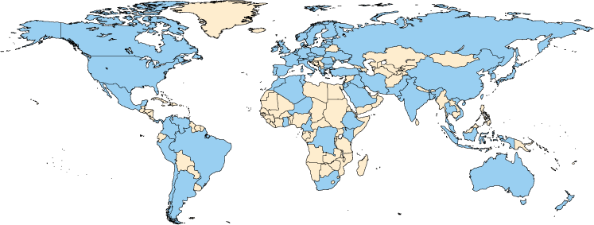
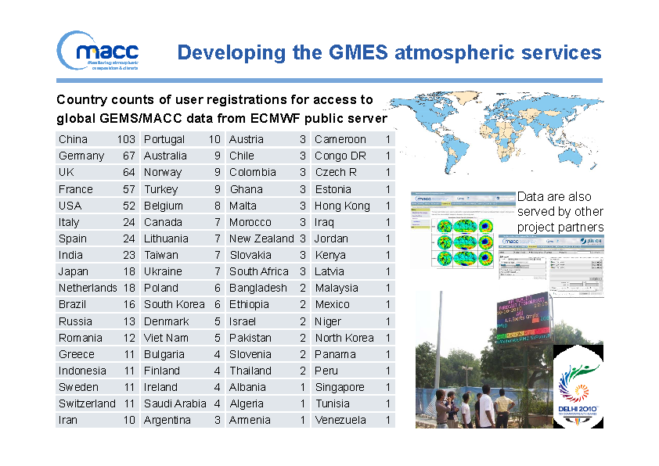
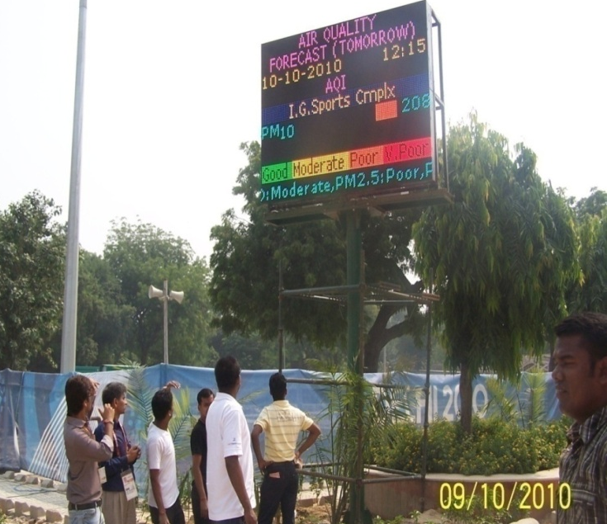

Worldwide users
800+ users of numerical data
ECMWF servers access by institutions
Notes:
The users basis of MACC-II is truly global, as the products delivered have little equivalent.

Slide 13
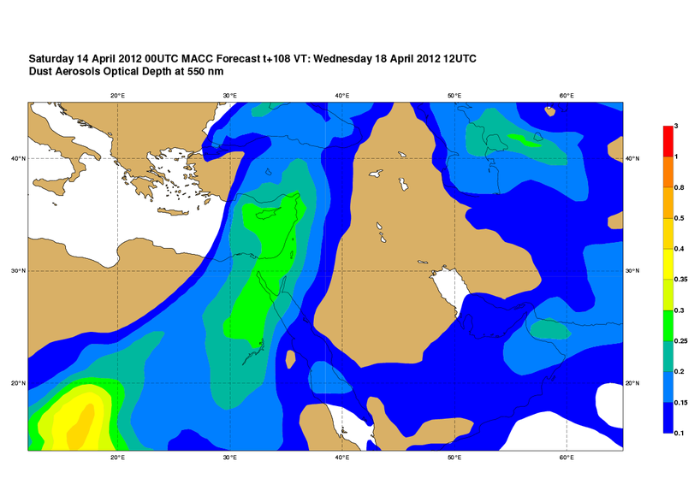
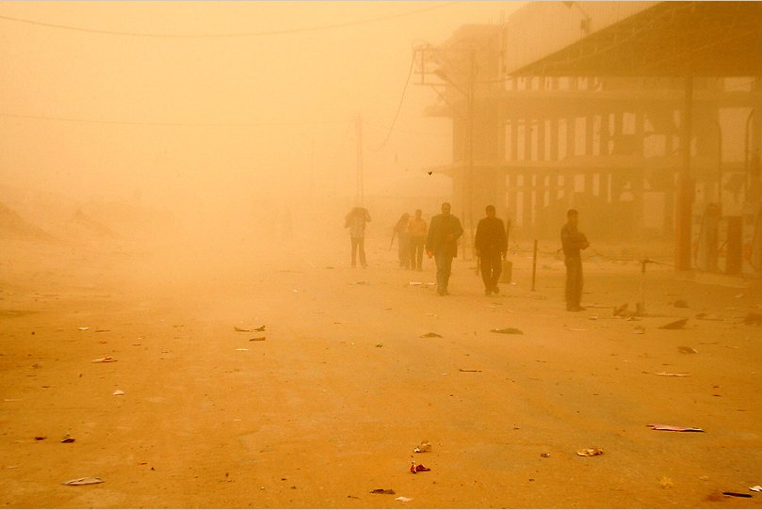

Dust storm 18/4/2012
Day 4
Gaza Strip
Notes:
First example: forecast of a dust plume affecting the Gaza Strip in April 2012: it was seen 4 days in advance.

Slide 14
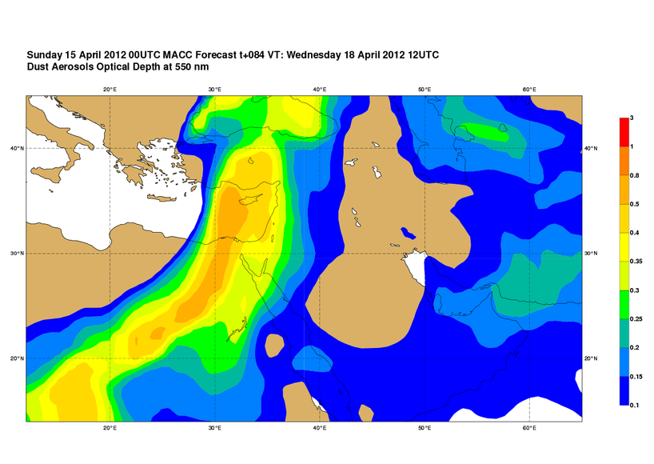
Dust storm 18/4/2012
Day 3
Gaza Strip
Notes:
First example: forecast of a dust plume affecting the Gaza Strip in April 2012: it was seen 4 days in advance.

Slide 15
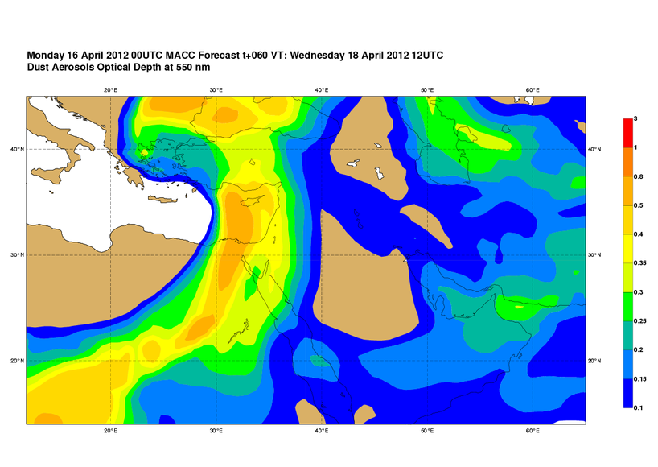
Dust storm 18/4/2012
Day 2
Gaza Strip
Notes:
First example: forecast of a dust plume affecting the Gaza Strip in April 2012: it was seen 4 days in advance.

Slide 16
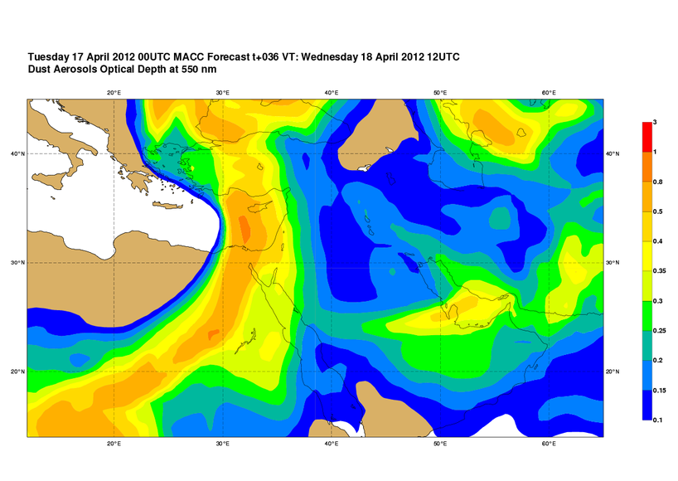
Dust storm 18/4/2012
Day 1
Gaza Strip
Notes:
First example: forecast of a dust plume affecting the Gaza Strip in April 2012: it was seen 4 days in advance.

Slide 17
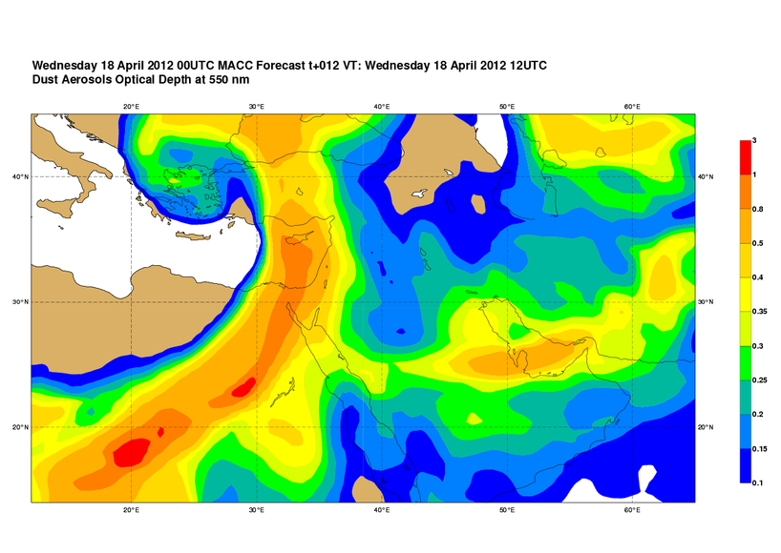
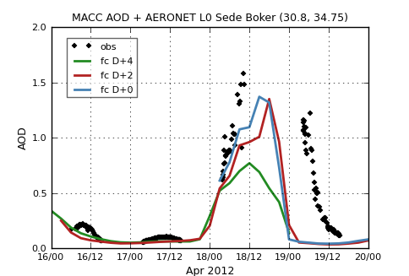
Dust storm 18/4/2012
Analysis
Gasah strip
Notes:
First example: forecast of a dust plume affecting the Gaza Strip in April 2012: it was seen 4 days in advance.

Slide 18
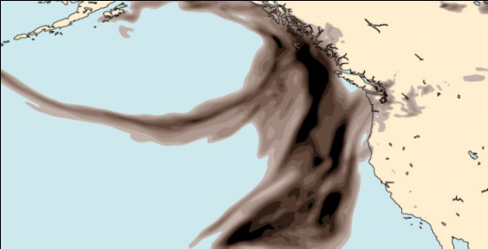
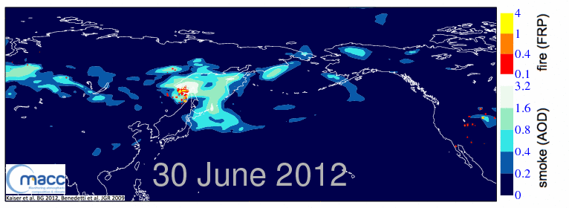
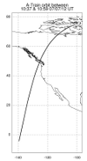
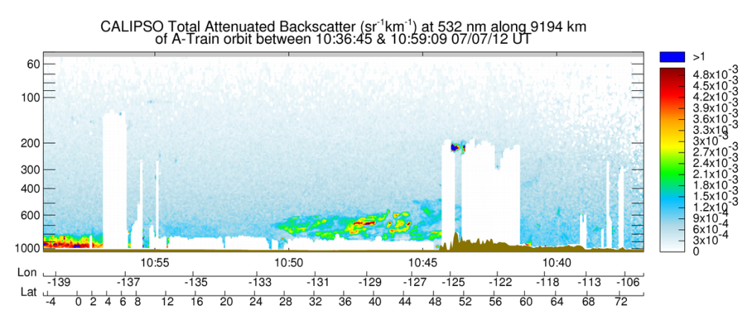
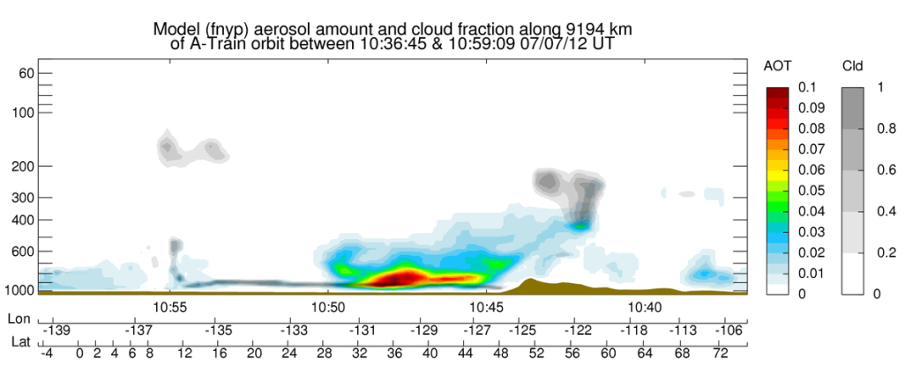
Where is the July 2012 Seattle haze coming from?
MACC-II has estimated that the global amount of biomass burnt last June was the highest of the past decade, with wildfires particularly acute in boreal forests in North-America and Asia.
Ubiquitous sources!
Independent validation against CALIPSO
Notes:
The MACC-II systems uses satellite-derived “Fire Radiative Power” to infer emissions for large fires as well as data assimilation of Aerosol Optical Depth to constrain the long-range transport of plumes. In July 2012, MACC-II helped understand a thick haze that affected the Seattle area… which was actually coming from Asia (not fires raging at the same time in Central US). The comparison with the independent CALIPSO data is confirms that the plume was excellently captured by the MACC-II system.

Slide 19
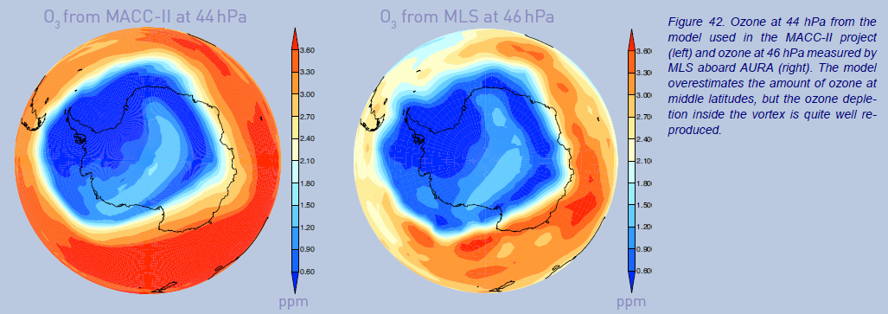
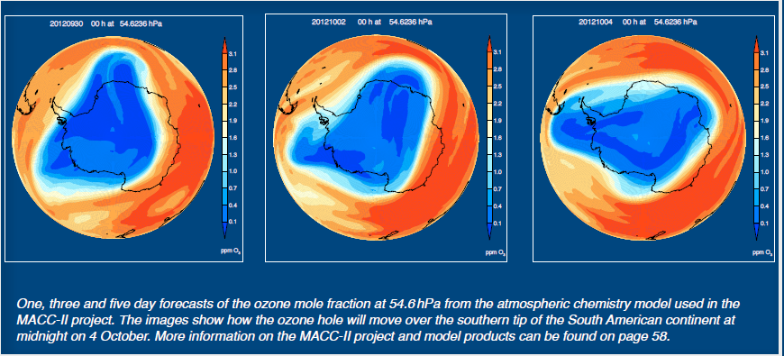

Use of MACC-II and MLS in WMO Antarctic
Ozone
bulletin
Notes:
MACC-II results feature now in WMO ozone hole bulletin and forecasts are used, for instance, to launch ozonesondes in Ushuaia (to target the ozone hole).

Slide 20
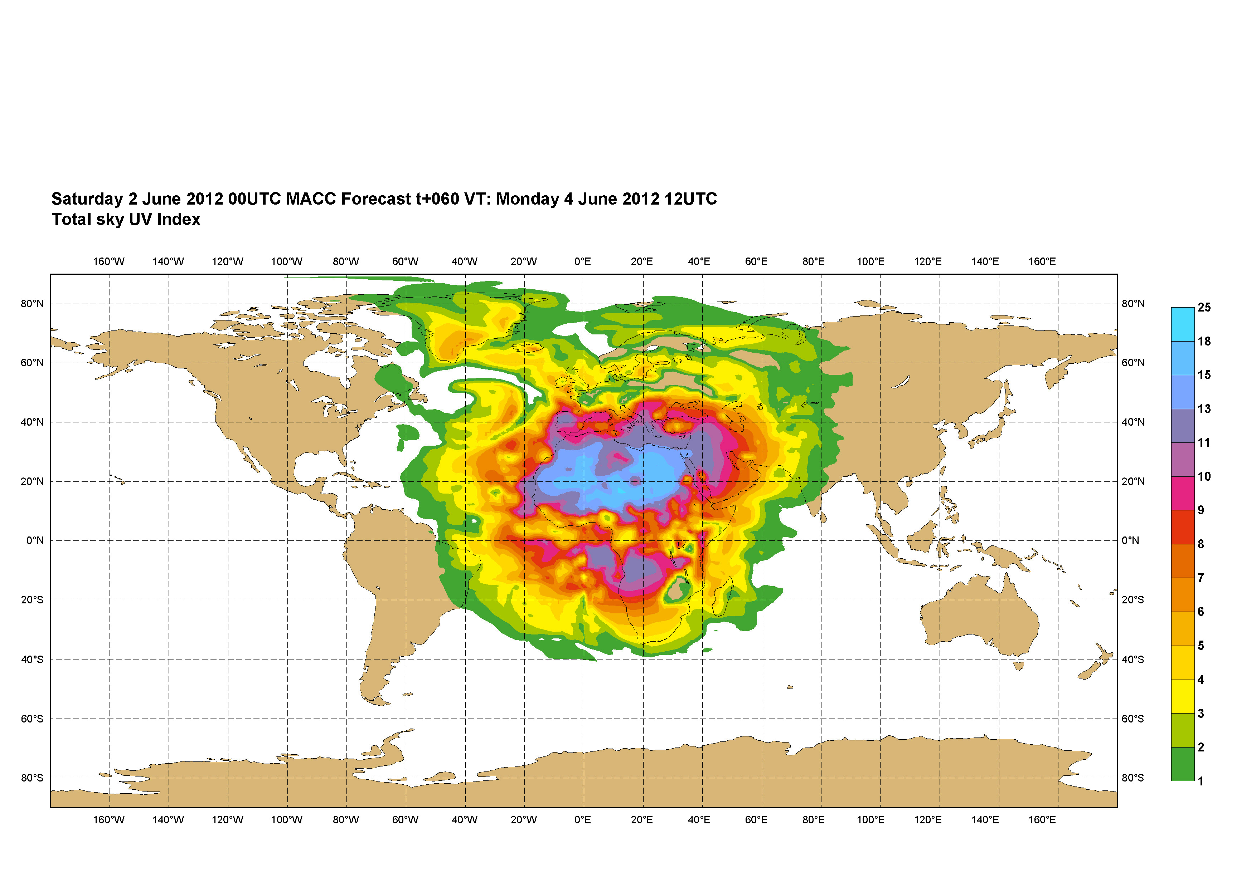
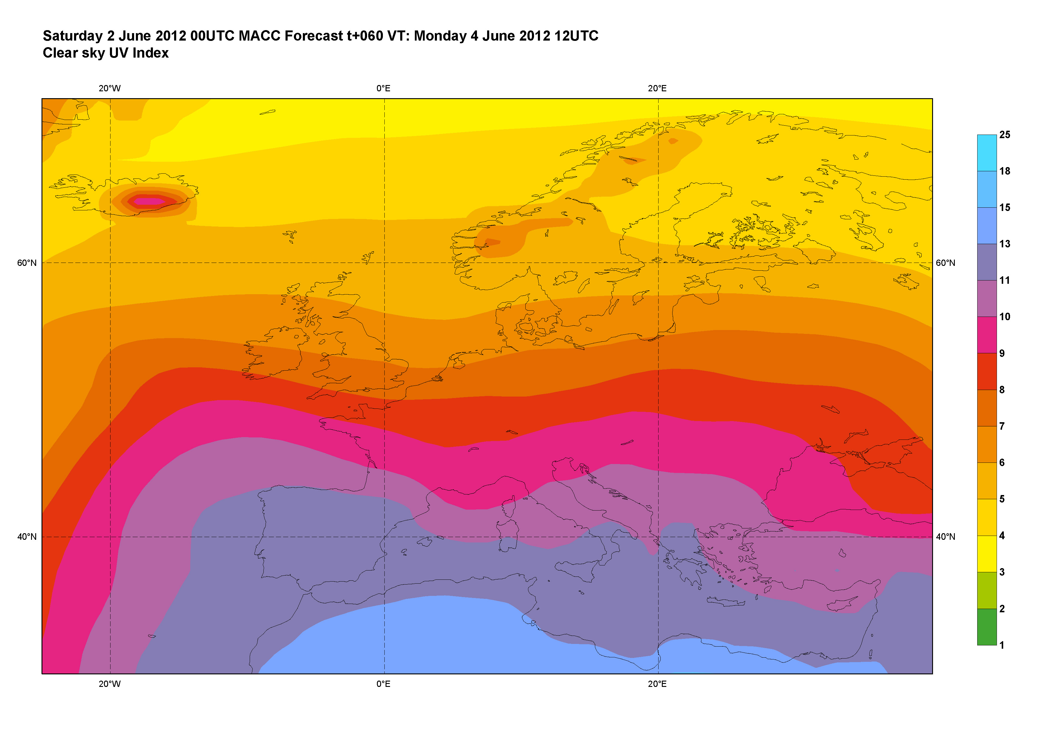
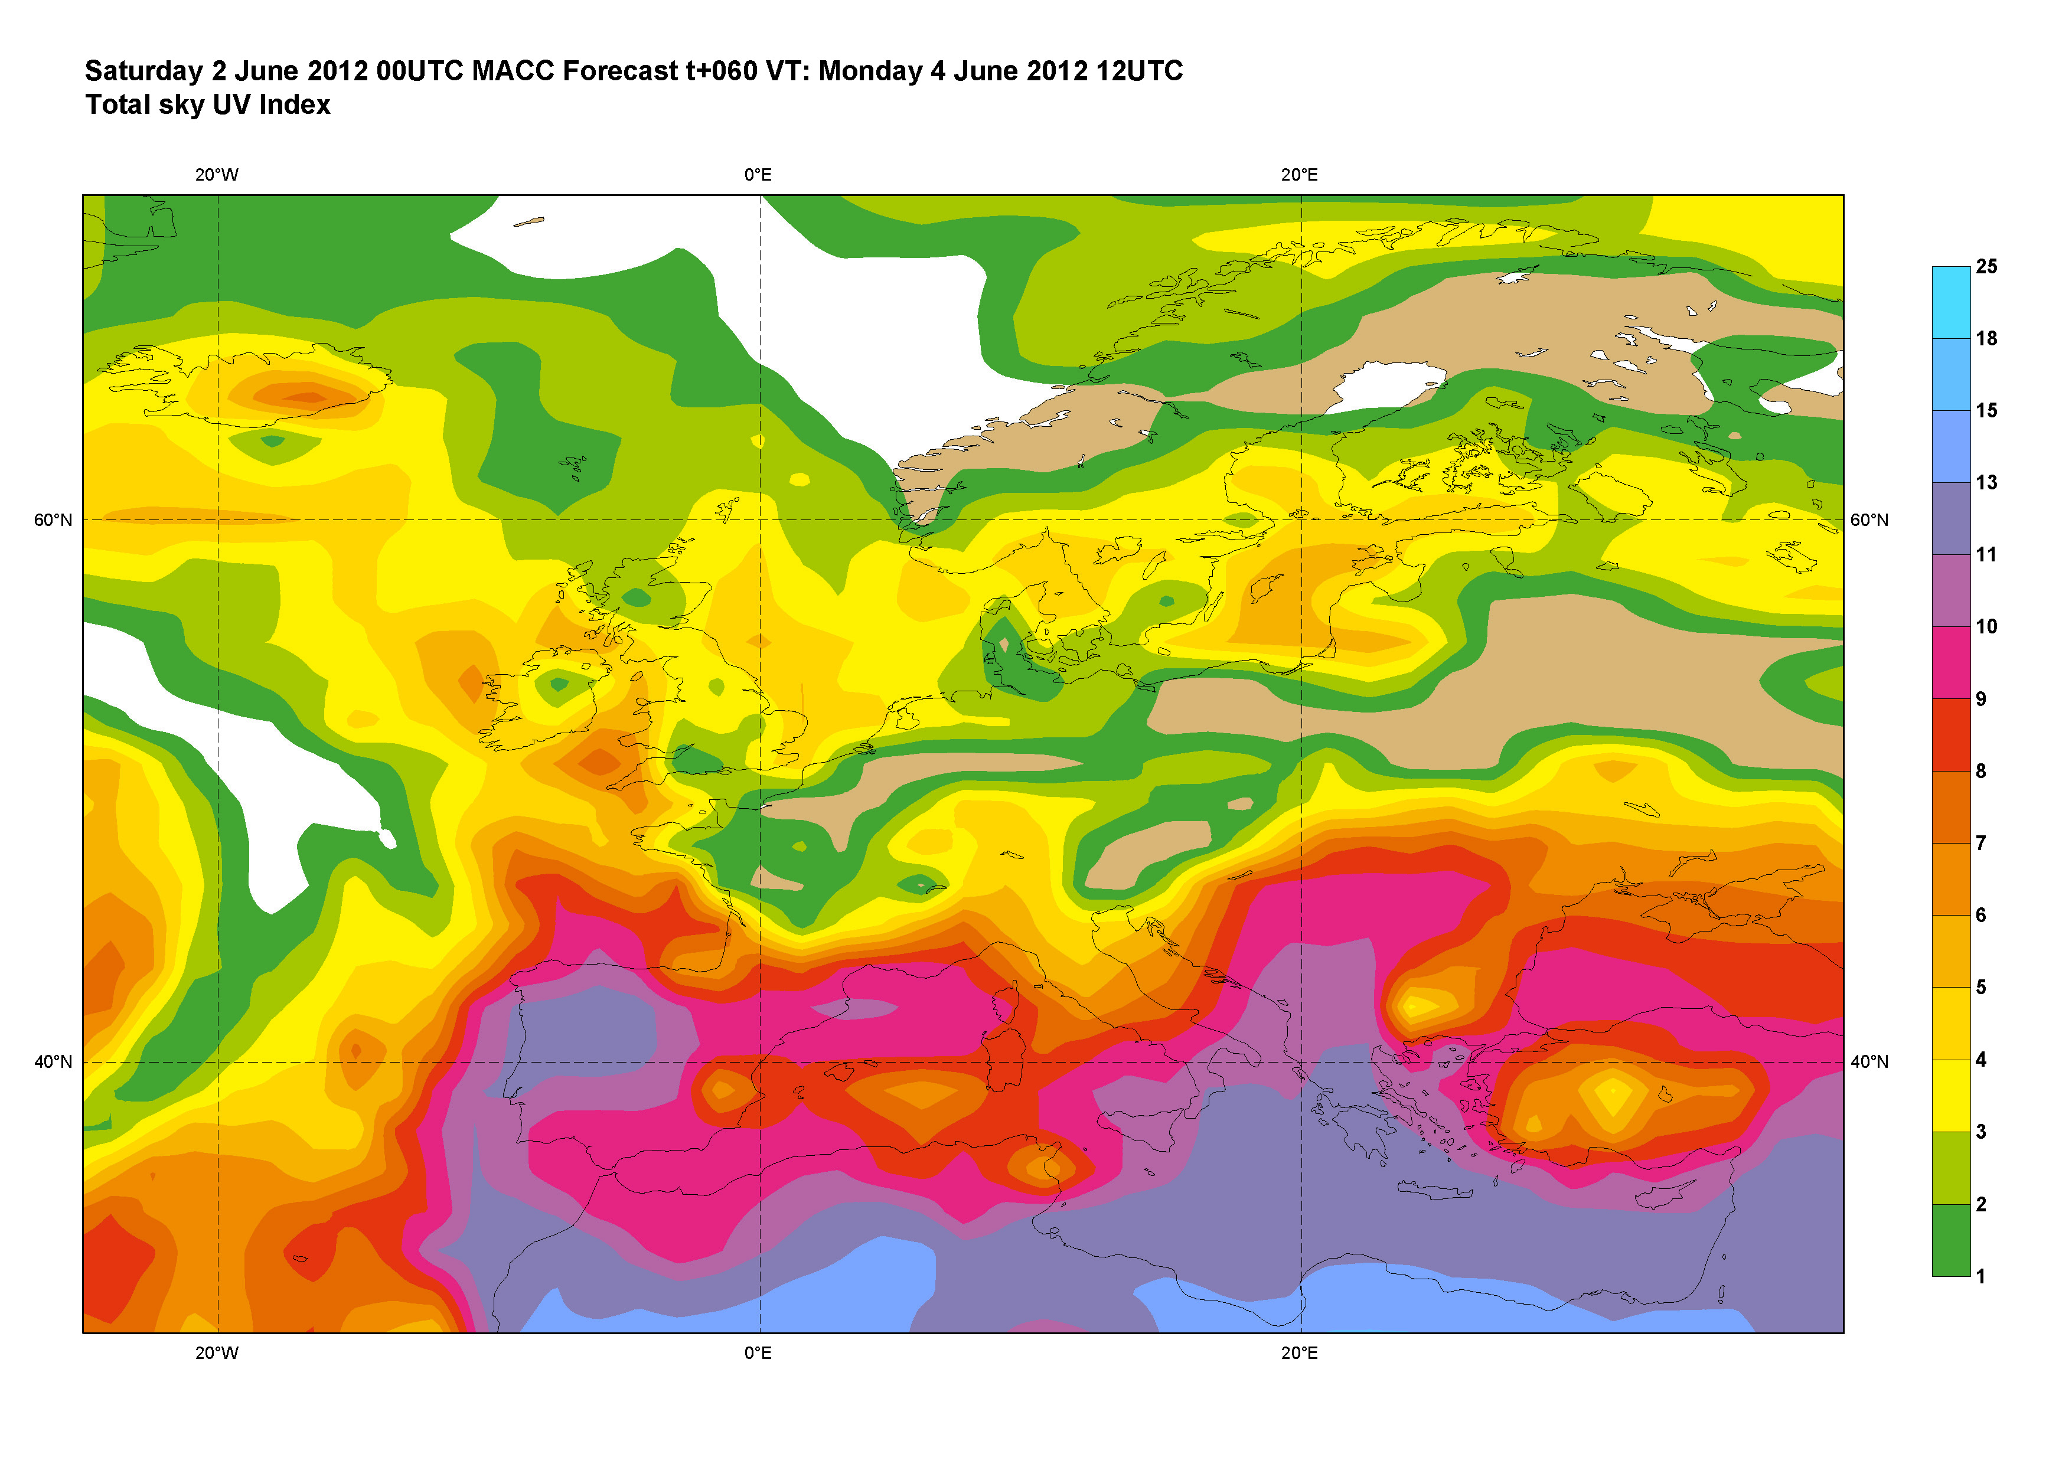
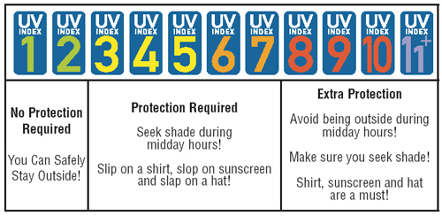
UV Forecast
Clear-sky (aerosol)
(clouds and aerosol)
Notes:
UV (and solar, reference to the ENDORSE presentation) radiation are also part of MACC-II products. The key step forward brought by MACC-II is the use of time-dependent and accurate aerosol representation.

Slide 21






MACC European Regional AQ ensemble
CHIMERE
INERIS, CNRS
Current geometry
Assimilation method
Operations
25 km, L8, top : 500 hPa
Optimal Interpolation
run @ INERIS
EMEP
met.no
0.2 °, L20, top : 100 hPa
3d-var in development
run @ met.no
EURAD
FRIUUK
15 km, L23, top : 100 hPa
Variational, 3d-var
run @ ECMWF
L-EUROS
TNO, KNMI
15 km, L4, top : 3.5 km
Ensemble Kalman Filter
run @ KNMI
MATCH
SMHI
0.2 °, L40, top : 100 hPa
Variational, 3d-var
run @ SMHI
MOCAGE
MF, CERFACS
0.2 °, L47, top : 5 hPa
Variational, 3d-var
run @ MF
SILAM
FMI
0.2 °, L46/5, top : 100 hPa
Variational, 4d-var
run @ FMI
+ same emissions, same met forecasts (IFS), same chemical boundary conditions (MACC global) : spread comes from differences in CTM formulation
Notes:
The regional air quality services are operated using an ensemble of seven leading European models. This is really european cooperation at its best.

Slide 22
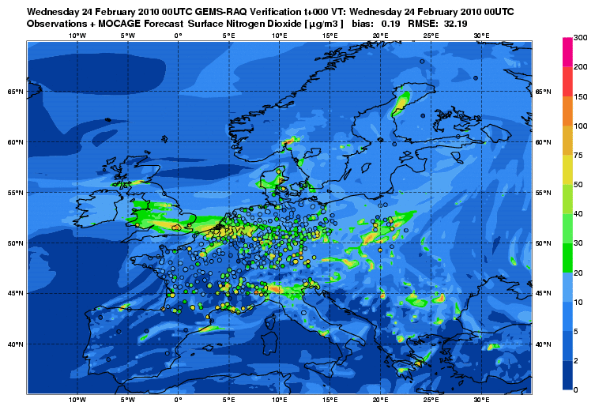
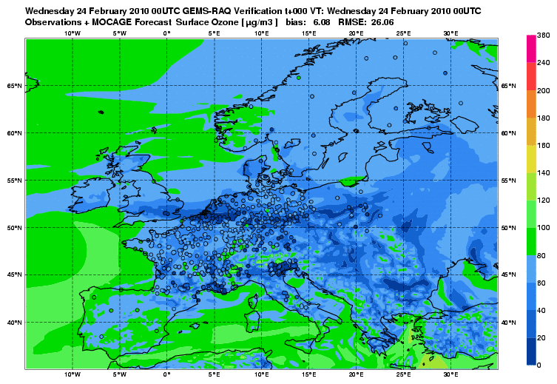
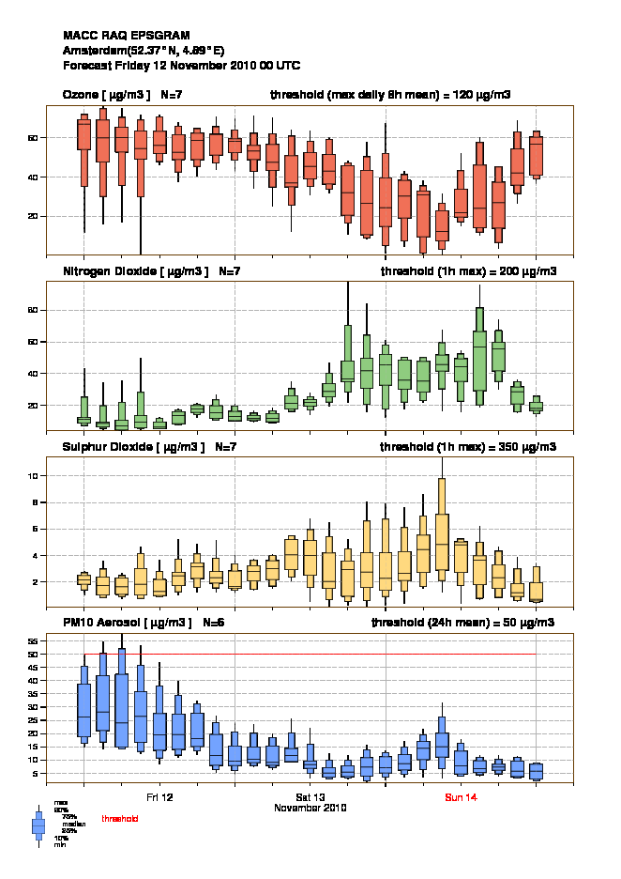
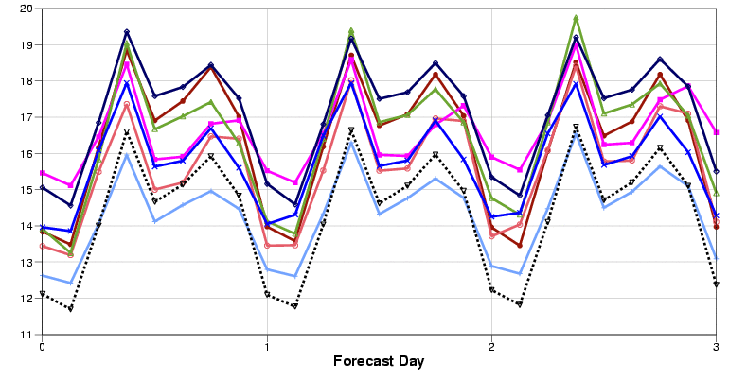
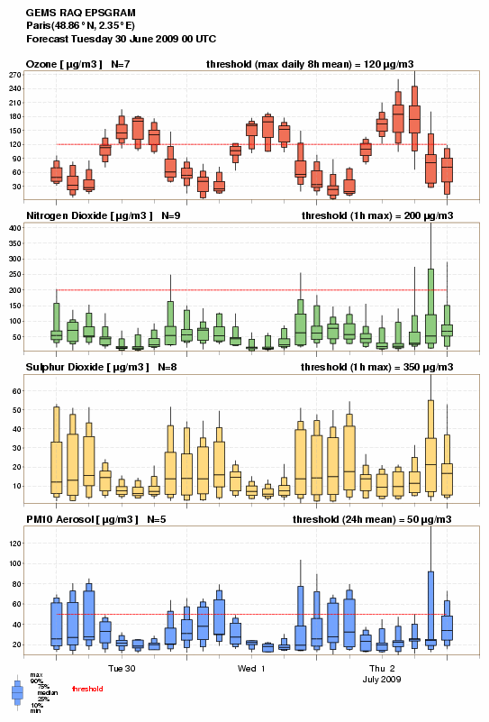
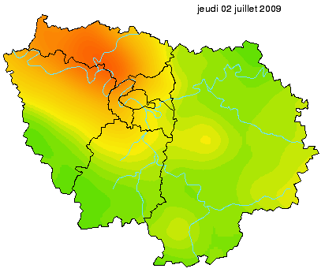


Why an ensemble approach?
An ensemble of models provides additional useful products…
All the individual models have their golden days…
… but the median of the ensemble has always among the best skill scores (here PM10 RMSE for ASO 2010).
…especially when situation is complex
Notes:
The many advantages of ensemble forecasting.

Slide 23
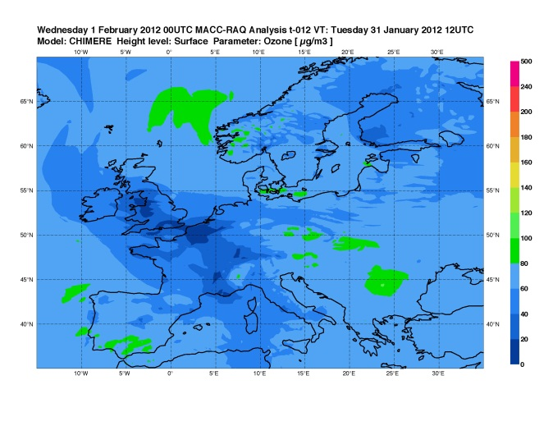
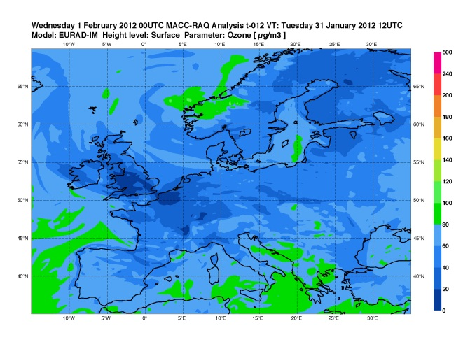
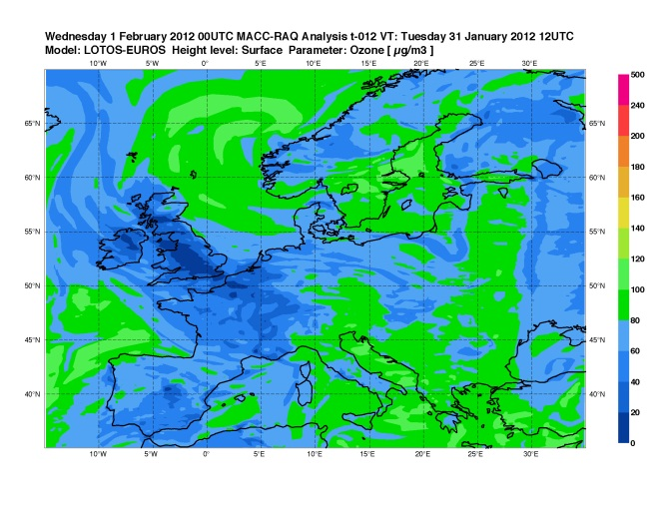
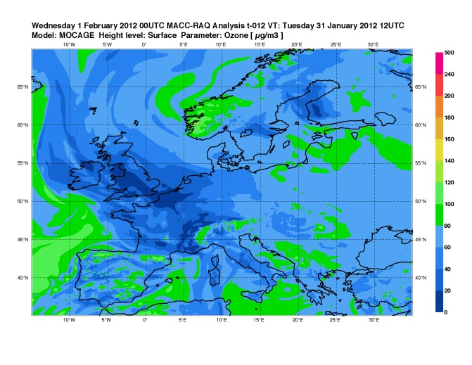


Ensemble of European Air Quality Analyses
Improved timeliness of dataflow could permit to base forecasts and further improve skill
Notes:
All the seven systems use data assimilation, in particular of surface data. Improvement in the timeliness of the observational dataflow in collaboration with the European Environment Agency will allow to use the analyses to base forecasts, with further improvement in skill to expect.

Slide 24








From model forecasts to exposure
London April 2011 high PM event
Exposure at home
Exposure during journeys
Notes:
MACC-II data over Europe can be used as an input for assessing the background contribution to exposure of people. Additional high-resolution modelling or statistical approaches are needed for this (example of the work of Imperial College London).

Slide 25









Pollen forecasting in MACC-II
Natural allergens are atmospheric pollutants
Far more direct and immediate than chemicals
Strong / dominant role of anthropogenic factors in emission
Highly specific mitigation measures
Pollen (20-60 um in size) flies
… far: 10³ km from source areas
dry deposition velocity ~1-2 cm sec⁻¹
already 1% of mass reaching remote region is enough to cause symptoms
Observation-based forecasts miss the transport
OK during the local season if local sources are dominant
not acceptable at the beginning and end of the season
Dispersion models reproduce the transport
… but require extensive supplementary information
… and have problems with absolute concentration levels
Birch fraction
map
Start of flowering
Temp. sum threshold
Pollen concentr. [#/m3]
NWP
Courtesy of S.Jaeger, data: EAN
Dispersion
Model
release
transport
sinks
Nbr of pollen grains
(% vs normal)
Temperature sum
difference:
TS(end)-TS(start)
Temp. sum pollen still in
catkins, %
Notes:
Pollen forecasting with the same tools as those used for air quality forecasting is also an important actitvity. First pre-operation trial to take place from Feb/March 2013! Allergies to pollen affect ~25% of the European population and taking medication in advance is very effective: thus, significant benefit to expect from this service.

Slide 26

A new MACC-II Service: NRT CO₂ forecasts
Notes:
High-resolution CO2 forecasts (16km global scale) have recently been set-up in answer to users request. On this animation, the storm Sandy (very well captured by the ECMWF system) can be seen in the CO2 structures. The variability in CO2 is important for a range of application, including assimilation of meteorological data (radiances).

Slide 27

Conclusions
MACC-II delivers products on the regional and global scales
MACC-II is the effort of an entire consortium
Number of partners run pre-operational systems
Wider research activities to maintain the best international level
MACC-II has a truly European dimension and is a key cost-effective and value-adding element in the service chain from the acquisition of observations to the service of a wide range of users
MACC-II has the ambition of being world-leading regarding the quality of atmospheric composition forecast and re-analysis products.
In the thematic areas covered, MACC-II aims at providing its support to EU DGs, EEA, EU member states and other organizations (VACCs, National Environment Agencies and Met Services…)
Interaction with users and further service providers (downstream) is essential
Notes:
MACC-II is the effort of an entire consortium. Only a limited number of partners actually run pre-operational systems, but we rely on wider research activities (developments, algorithms, validation…) that are essential to maintain at the best international level, very much like it is the case for operational NWP.
MACC-II has a truly European dimension and is a key cost-effective and value-adding element in the service chain from the acquisition of observations to the service of a wide range of users.

Slide 28
Credits
Lucien Wald (MINES Paristech) Vincent-Henri Peuch (ECMWF) & the MACC-II consortium
http://www.gmes-atmosphere.eu/documents/maccii/presentations/Wald-Peuch_MACCII_GEO_Nov2012.pptx

Slide 29
Pasodoble

Slide 30
Overview
PASODOBLE aims to provide information and support for regions and cities that are affected by air pollution
Myair Service is a service being developed that combines space-based data, in-situ measurements and modelling for use in four thematic areas:
Health community support
Public forecasting and assessment
Compliance monitoring support
Local forecast model evaluation support
PASODOBLE has developed solutions for improving quality of life and sustainability of wellbeing by raising awareness, reducing health costs and decreasing morbidity caused by air pollution
Notes:
As part of the European Earth Observation Programme (Copernicus), the PASODOBLE project aims to provide information and support for regions and cities that are affected by air pollution. By combining space-based data, in-situ measurements and modeling, the ‘Myair service’ portfolio is being developed and demonstrated for users in four thematic areas:

Slide 31
Public Forecasting and Assessment Services (1/2)
Develops and integrates dedicated, high-quality air quality services for protecting human well-being
Target users are the public and specific population groups
Mainly based on services developed and demonstrated within the scope of PROMOTE and aims at their further advancement
Main objective is to satisfy the needs for integrated and specific information on air quality that is important for selected population groups, associations, authorities, and professionals
Notes:
This service line develops and integrates dedicated air quality services which are of high value for protecting human well-being and have direct implications for outdoor activities, mobility, recreation and sports. The target users are the public and specific population groups. The service line is mainly based on services developed and demonstrated within the scope of PROMOTE and aims at their further advancement and stronger integration. The major goal of the services is to satisfy the needs for integrated and specific information on air quality that is important for selected population groups, associations, authorities, and professionals

Slide 32
Public Forecasting and Assessment Services (2/2)
The integration effort follows two main directions:
Region-wise = comparison of approaches from individual services for larger inter-connected regions
Achieved by implementing air quality indicators (multi-regional and region-specific)
Topic-wise = development and implementation of integrated atmospheric assessment programmes
Integrates parameters from different thematic areas; ozone, particulate matter (PM), airborne allergens and UV
The goals reflect the needs of the users and will result in a set of broad and customised products:
Air quality forecasts for regions and cities
Tailored regional and local air quality products for sports, tourism, traffic management, regional fire monitoring, and aeroallergen information
Notes:
Region-wise inter-comparison and harmonisation of approaches of individual services for larger inter-connected regions will be carried out through implementation of air quality indicators with multi-regional viability – in addition to region-specific products – while maintaining the existing diversity of focused end-products, largely originating from regional specifics of environmental problems and the population’s sensitivity to them.
Topic-wise development and implementation of integrated assessments of meteorological and chemical characteristics of the atmosphere will integrate parameters from different thematic areas, such as ozone, particulate matter (PM), airborne allergens and UV.
The goals reflect the specific needs of the users and will result in a set of general-use and focused products:
Air quality forecasts for regions and cities evolving from PROMOTE services
Tailored regional and local air quality products for sports, tourism, traffic management, regional fire monitoring, and aeroallergen information

Slide 33

Pasodoble Airsheds
Copernicus Atmosphere Service provides AQ analysis and forecast at a resolution of 15 km – 30 km over Europe
Myair regional, local and urban downstream services at resolution of 1 km – 5 km
To bridge the gap, regional air quality forecasts with a resolution of 5 km – 7 km, were established: Pasodoble Airsheds

Slide 34

Pasodoble Airsheds
Pasodoble provides five regional airsheds:
Central, Western and Southern Europe
EURAD-IM model
In-situ data and data from OMI, GOME-2, SCIAMACHY
Central and Southern Europe
Chimere model
ACRI-ST IC-Airshed forecast system
Northern Europe
SILAM model
HIRLAM NWP metereological input
South-East Europe
CAMx model
ACRI-ST IC-Airshed forecast system
Joint Airshed
LOTOS-EUROS model
KNMI/RIVM/TNO IC-AIRSHED system

Slide 35

obsAIRve

Slide 36
Overview
obsAIRve is an EU-funded Copernicus pilot downstream service
Integrates scientific air quality data from different data sources
Through obsAIRve, European citizens will benefit from air quality monitoring networks and air quality modelling
Additionally, obsAIRve has conducted an ideas competition to raise public awareness
Notes:
obsAIRve is an EU-funded pilot service making use of data provided through the European earth observation program and data that is available from local monitoring stations. Global Monitoring for Environment and Security (GMES) will provide accurate, timely and easily accessible information to improve the management of the environment, while helping to understand and mitigate the effects of climate change and ensure the safety and security of European citizens. The GMES program is led by the European Union (EU) and consists of a complex set of systems collecting and processing data from multiple sources (earth observation satellites and in situ sensors such as ground stations, airborne and sea-borne sensors).
Through obsAIRve, European citizens will benefit from earth observation, air quality monitoring networks and air quality modeling.
Additionally, obsAIRve will conduct an ideas competition to raise public awareness on the topic of air pollution and health by asking European citizens for concepts and ideas of how to communicate air quality to the public

Slide 37
obsAIRve Objectives
obsAIRve aims to provide air quality information for European citizens – available as web-based air quality service and smartphone apps
obsAIRve converts complex scientific results from EU research projects into easy-to-understand services for European citizens
Designed to explore market opportunities
Considers air pollutants of primary concern: Ozone, NO₂ and fine particles
Notes:
obsAIRve aims to provide air quality information for European citizens in an efficient, easy to understand way – available as web-based air quality service and smartphone app.
The topics of air quality/air pollution and health are targeted by a multitude of European research projects. obsAIRve converts the complex scientific results these projects obtain into an easy to understand information service dedicated to European citizens. The pilot service “obsAIRve” will include scientific forecasts and observations. It is designed to explore market opportunities based on user inclusion and public awareness campaigns foreseen during all phases of project implementation. Air pollutants of primary concern, such as ozone, NO₂ and fine particles, are considered.

Slide 38

About obsAIRve
Funded by DG Enterprise & Industry
Project lead: GAF AG
Consortium partners:
T-Systems
DLR
Environment Agency Austria
Strong Pan-European network:
European Institutions and European projects (EEA, MACC, Pasodoble)
Scientific organisations (German Aerospace Center, Universities)
Regional LMOs (Airparif, DCMR, EGMASA)
Municipalities (Vienna, Paris, Frankfurt, Rome, Sofia)
Commercial organisations (Weather services, telecommunication providers, broadcasting services)
Project duration: 01/2011 – 12/2013

Slide 39

obsAIRve data providers
obsAIRve integrates AQ forecasts and observations from several scientific networks and projects:
Forecasts
Copernicus Core Service: MACC II Ensemble Model (European-wide coverage)
Pasodoble Airshed Blackforest Region
Pasodoble Airshed TNO KNMI (scheduled)
Observations (in-situ data)
Current measurements (station data) from European national environment agencies, bundled by EEA
Background / Traffic indices for main European cities (Citeair project, bundled by Airparif)

Slide 40

obsAIRve Air Quality Service
Notes:
obsAIRve aims to provide air quality information for European citizens in an efficient, easy to understand way – available as web-based air quality service and smartphone app.
The topics of air quality/air pollution and health are targeted by a multitude of European research projects. obsAIRve converts the complex scientific results these projects obtain into an easy to understand information service dedicated to European citizens. The pilot service “obsAIRve” will include scientific forecasts and observations. It is designed to explore market opportunities based on user inclusion and public awareness campaigns foreseen during all phases of project implementation. Air pollutants of primary concern, such as ozone, NO₂ and fine particles, are considered.

Slide 41
obsAIRve Air Quality Service
obsAIRve provides an easy comprehensible AQ information product:
Heterogeneous AQ data are combined into one service
Two types of information: Scientific forecasts (models) and observations (measurements)
All air quality data is converted into a single index: the Common Air Quality Index (CAQI)
Vizualisation of CAQI is colour coded
CAQI 100 colour scale
Notes:
obsAIRve aims to provide air quality information for European citizens in an efficient, easy to understand way – available as web-based air quality service and smartphone app.
The topics of air quality/air pollution and health are targeted by a multitude of European research projects. obsAIRve converts the complex scientific results these projects obtain into an easy to understand information service dedicated to European citizens. The pilot service “obsAIRve” will include scientific forecasts and observations. It is designed to explore market opportunities based on user inclusion and public awareness campaigns foreseen during all phases of project implementation. Air pollutants of primary concern, such as ozone, NO₂ and fine particles, are considered.

Slide 42


obsAIRve Communication Channels
Web site: www.obsairve.eu

Slide 43


obsAIRve Communication Channels
iPhone app
More than 2500 downloads
Full functionality as in web portal
https://itunes.apple.com/de/app/obsairve/id490939811?mt=8

Slide 44

obsAIRve Communication Channels
Android app
Available in Google PlayStore
New Release end 2013

Slide 45


obsAIRve Ideas Competition
Concepts and ideas for dissemination of Air Quality information
Launched at CeBIT 2012
Idea of the month wins an iPad 3
Until December 2012
First prize: A weekend trip to Berlin
Overall winner: Mr. Markus Kuntner from Austria

Slide 46
Public and LMO Approach obsAIRve and SILAM web-services

Slide 47
Contents
Some history and perspectives on obsAIRve - the GMES AQ downstream service
Data providers: MACC, Pasodoble, In-Situ data (station data)
In-Situ data:
Data from European local environment agencies, bundled by EEA
Citeair data bundled by Airparif
AQ portal data (FMI)
SILAM /THREDDS web-service developed for PASODOBLE
What the service is about
The main available communication channels
General info on the users: extent, type, requirements, main achievements/failures
Quick overview of some examples of possible use of the products
SILAM-user cases

Slide 48
The Copernicus Atmosphere Web Portal

Slide 49

Live Demonstration

Slide 50
The Test Cases Prototype

Slide 51

Long-Range Pollution Transport Impact
Live demonstration: http://89.202.228.212/

Slide 52
Tools to access and use the products

Slide 53

Panoply
Viewer for NetCDF datasets
MACC model data
Pasodoble data etc.
Developed by NASA
Goddard Institute for Space Studies

Slide 54

Panoply
Dimension views
lat-lon
lat-vert
lon-vert
time-lat
Global or regional map with more than 75 map projections
Different colour-bars
Several export formats supported

Slide 55

obsAIRve Applications
obsAIRve website and mobile apps
Current measurement data from ~ 6000 stations
European-wide forecasts for 3 days
General index, O3, NO2 and PM10

Slide 56
Feedback Forms
&
Questions
Notes:
Feedback forms will be distributed and people will be encouraged to complete them in this time.
Open floor up to questions.

